Slide 1
Automated Plant Monitoring System
PDS
https://github.com/amelcharolinesgn2/IoT
Notes:
https://drive.google.com/drive/folders/10Jn-lD_ae6PH-ixi1LViORn1hEgi-vII
https://github.com/Azure/opendigitaltwins-smartcities/blob/main/README.md
Flourish Farm Aquaponic Systems | The Aquaponic SourceLainnya

Slide 2


Slide 3

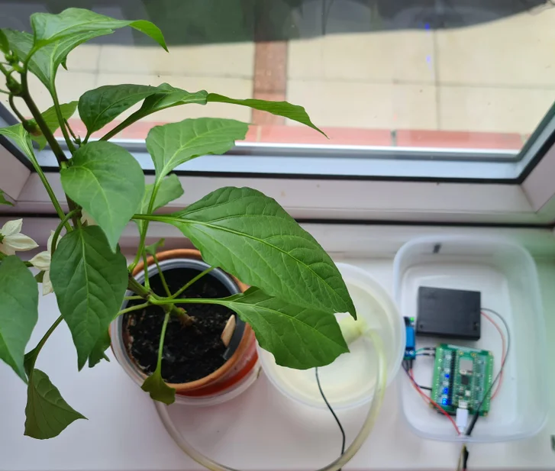

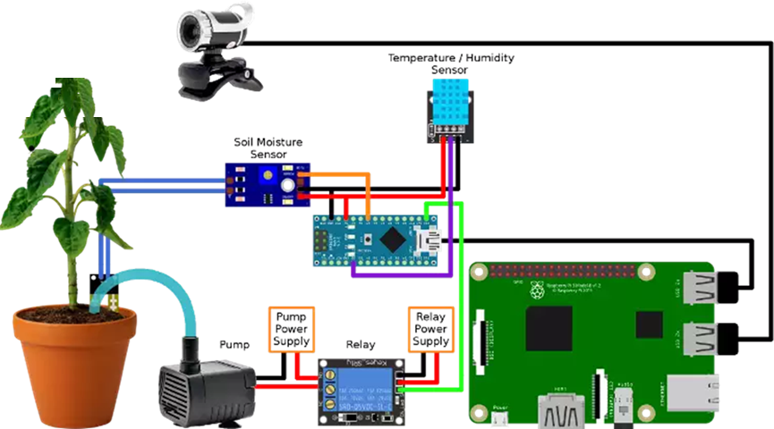

Building this system should take ~10 hours, depending on experience and any unforeseen issues.
Notes:
https://github.com/topics/plant-growth
https://ozeki.hu/p_2972-plant-watering-system-with-ozeki-10.html
https://www.instructables.com/PlantyPi-a-Raspberry-Pi-Pico-Plant-Watering-Device/
https://blog.balena.io/keep-your-plant-friends-happy-and-healthy-with-automated-watering-balenaplant/

Slide 4
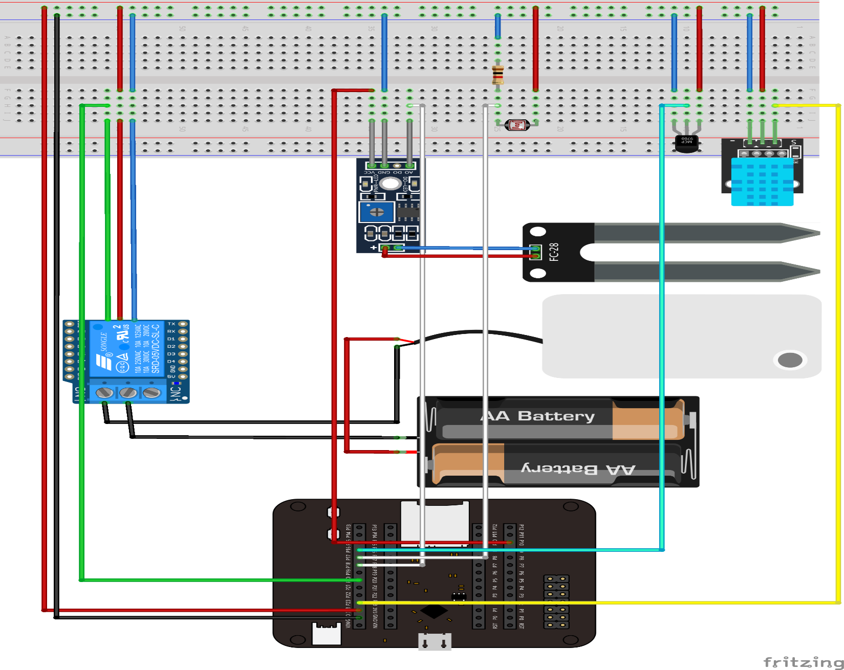

Slide 5
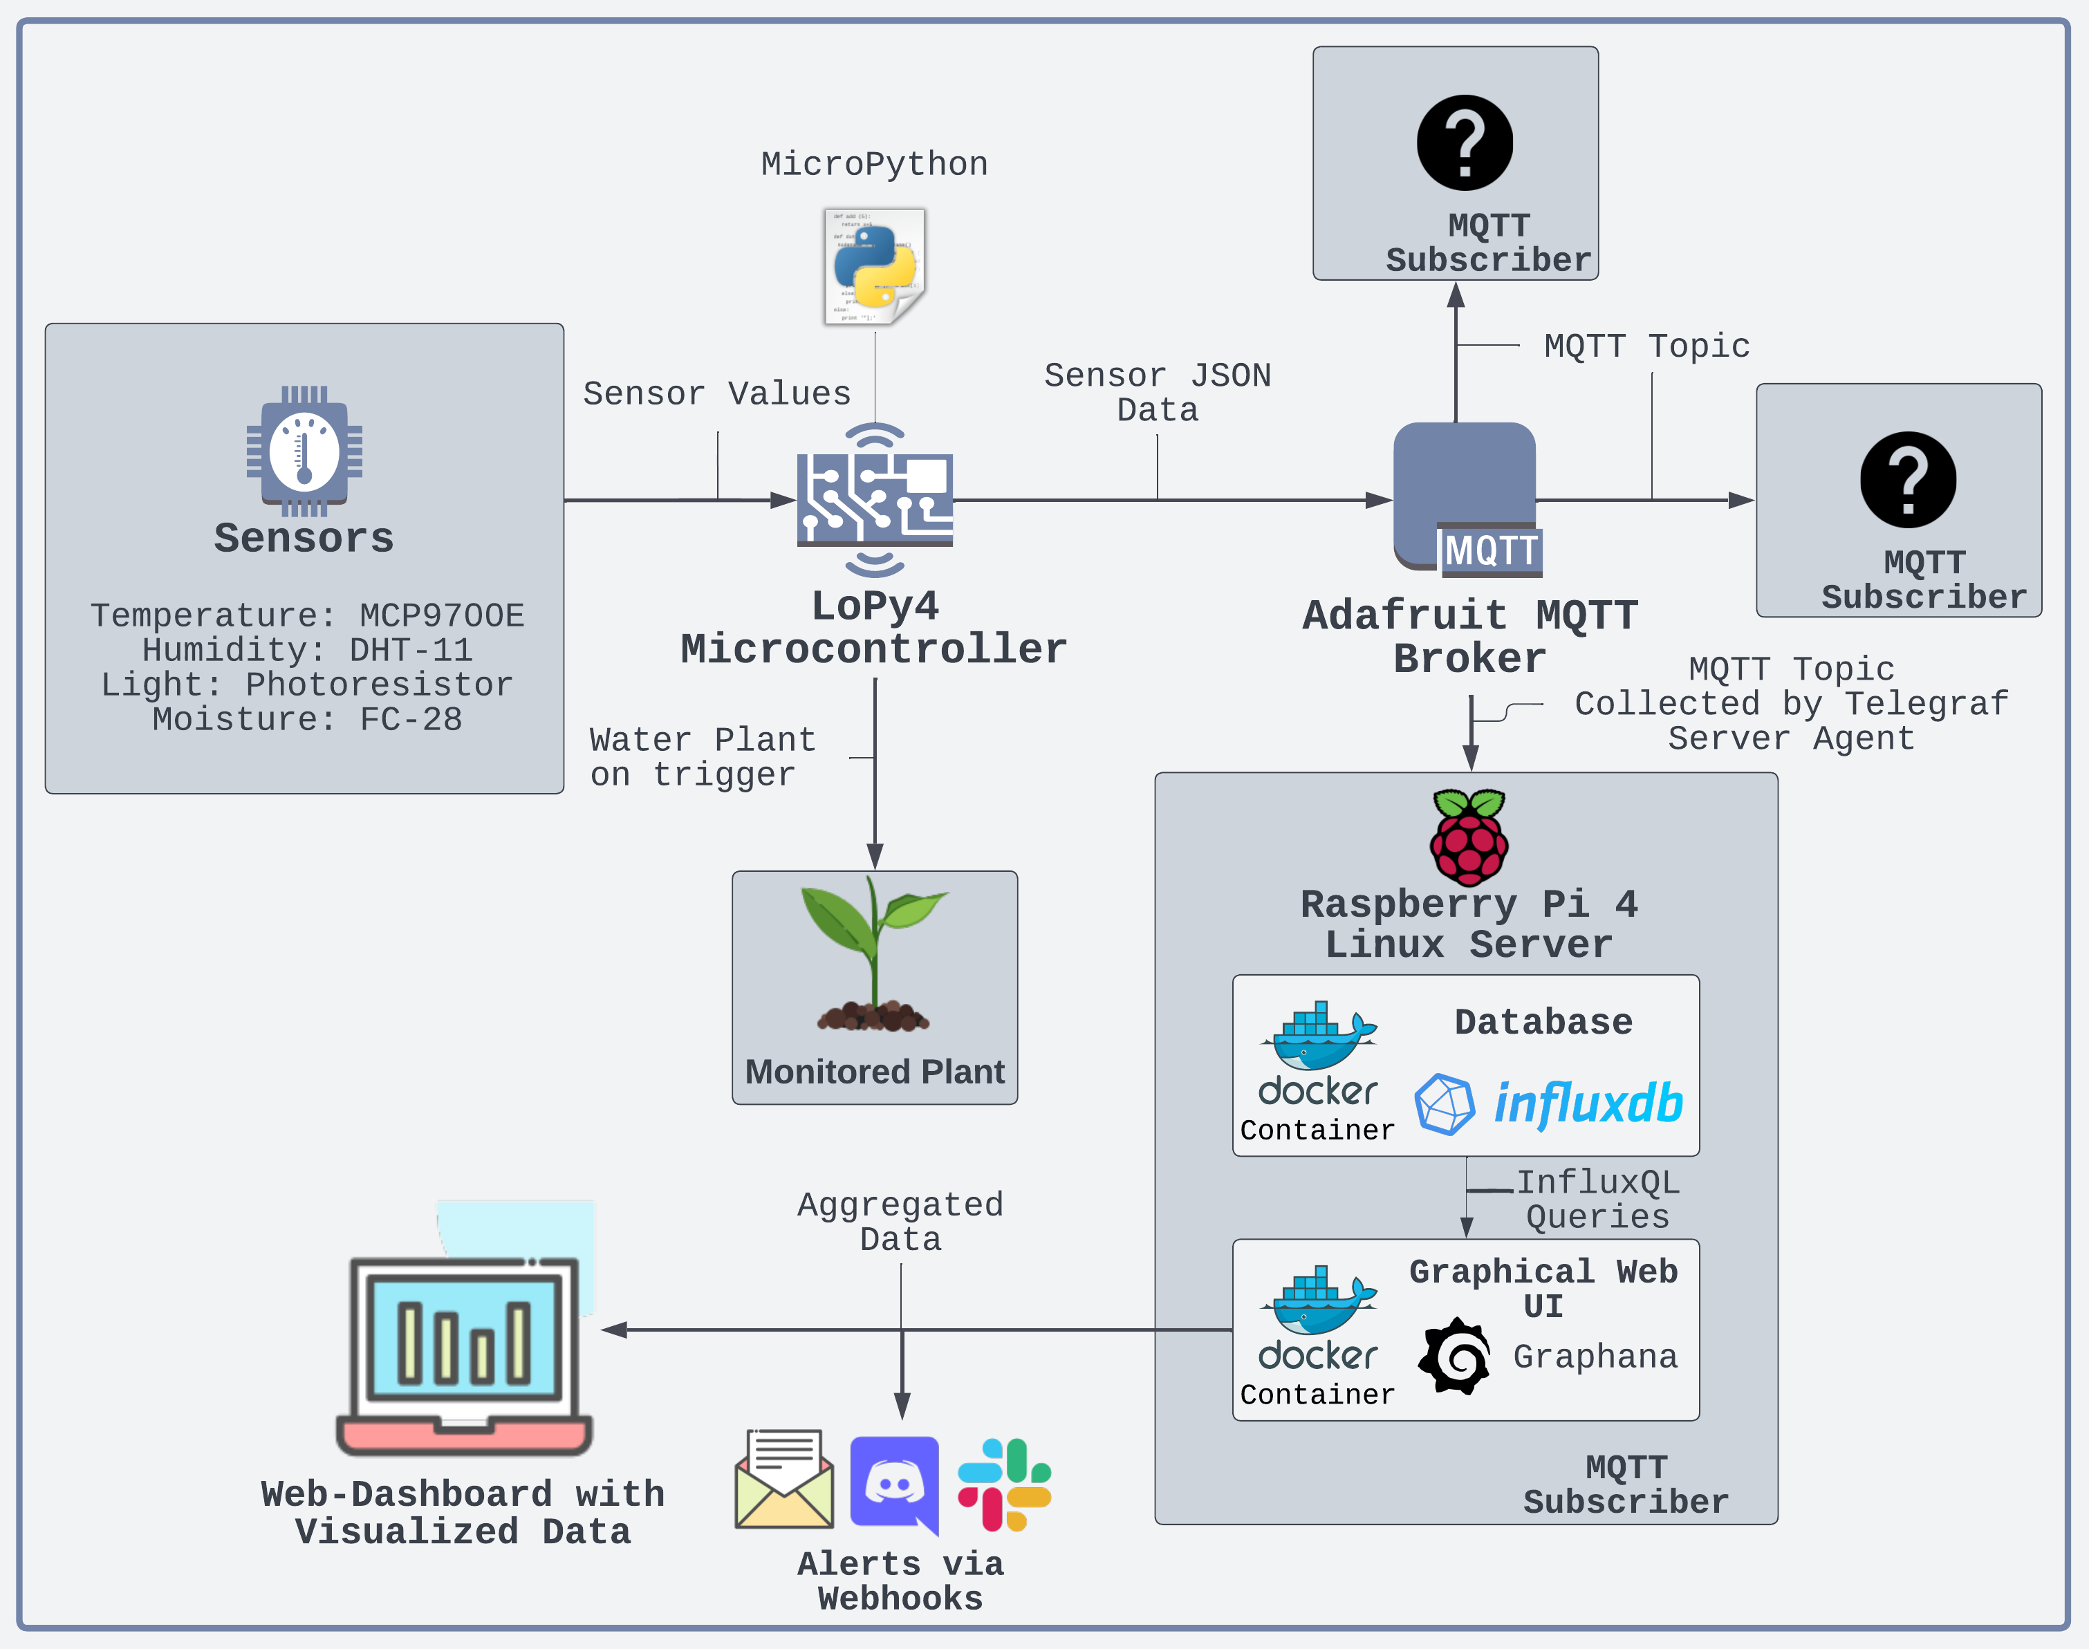
Purpose :
This system gives the user the possibility to monitor the environment of a certain plant. Temperature, air humidity, brightness and soil moisture can be studied in real time, as well as over timespans, using a graphical interface.
It also allows for alerts to be sent over email, Discord or other mediums using webhooks, and provides an automated watering system.

Slide 6
Objective :
I built this system so that I could monitor all relevant factors that can affect the growth of a plant over the internet, and to automate the process of watering the plant. It's also a very interesting project to make, since you will need to dive into many different field such as circuit theory, analog and digital signals, communication protocols, low level data communication, programming of self reliant persistent embedded systems, server, container and database technology among others.
Without this sensor data, many decisions about how to water, position the plant, control the temperature and humidity would be left to guesswork. But with access to present and historical data, a more scientific/data driven approach is possible.
The collected sensor data can be aggregated into useful KPI:s (Key Performance Indicators), which can help the user make informed decisions and conclusions about the growing of the plant.
Material :

Slide 7
Required components
Code_APMS (download newest version)
Raspberry Pi
Arduino Nano, Uno or Mega
Soil moisture sensor (soil hygrometer)
Water pump (submersible or jet pump) with pump switch relay
Jumper wires and at least 1 USB cable (between Raspberry Pi and Arduino)
Optional components
One of the following DHT air temperature, humidity sensors:
DHT11:0-50 °C (+/- 2°C accuracy) 20-80 RH (5% accuracy) Gets new data in every 2 seconds | DHT22:-40-80 °C (+/- 0.5°C accuracy) 0-100 RH (2-5% accuracy) Gets new data in every 2 seconds
Notes:
https://ozeki.hu/p_2972-plant-watering-system-with-ozeki-10.html

Slide 8
Data
Values based on a supply voltage of 5V. Where no average data available, the maximum value has been used.
Component | Mode | Current Draw
Microcontroller (LoPy4) | Active (WiFi client) Light Sleep (WiFi Off) | 107mA 30mA
MCP9700E | Active | 6µA
DHT-11 | Measure Sleep | 2.5mA 150µA
Photoresistor | Active | 3.3mA*
FC-28 | Measuring Off | 35mA 0mA
3V Submersible pump | On Off | 150mA* 0mA
5VDC Relay | On Off | 150mA 0mA
Notes:
Data Sources: LoPy4 Data Sheet, DHT11 Data Sheet, MCP9700 Data Sheet, Dual Comparators Data Sheet, SRD-05VDC-SL-C Data Sheet

Slide 9
Data Sources: LoPy4 Data Sheet, DHT11 Data Sheet, MCP9700 Data Sheet, Dual Comparators Data Sheet, SRD-05VDC-SL-C Data Sheet:
1* 3.3V, 1000ohm -> 0.01089W 3.3V, 0.01089W -> 0.0033A draw -> 3.3mA (Approximated) 2* Approximated from similar pumps
The system uses periodic sampling which is good because it's simple and sends data in regular intervals. It might however send duplicate data if nothing in the environment has changed, which is a waste of energy.
Based on timing measurements and estimations of current draw - the different system cycles and their current draw are the following:
Boot cycle: Time: 2s Current draw: 30mA(LoPy4) + 6µA(MCP9700E) + 150µA(DHT-11) + 3.3mA(Photoresistor) = 33.456mA
Setup cycle: Time: 3s Current draw: 107mA(LoPy4) + 6µA(MCP9700E) + 150µA(DHT-11) + 3.3mA(Photoresistor) = 110.456mA
Main cycle: Time: 4s Current draw: 107mA(LoPy4) + 6µA(MCP9700E) + 2.5mA(DHT-11) + 3.3mA(Photoresistor) + 35mA(FC-28) = 147.806mA
(Assuming all sensors are measuring for the full duration of the cycle - not realistic but better to make a high estimate.)
Pump cycle: Time: 5s if activated Current draw: 150mA (Pump) + 150mA (Relay) = 300mA from 2xAA
Light sleep cycle: Time: 300s Current draw: 30mA(LoPy4) + 6µA(MCP9700E) + 150µA(DHT-11) + 3.3mA(Photoresistor) = 33.456mA
Standby after sleep cycle: Time: 5s Current draw: 107mA(LoPy4) + 6µA(MCP9700E) + 150µA(DHT-11) + 3.3mA(Photoresistor) = 110.456mA

Slide 10
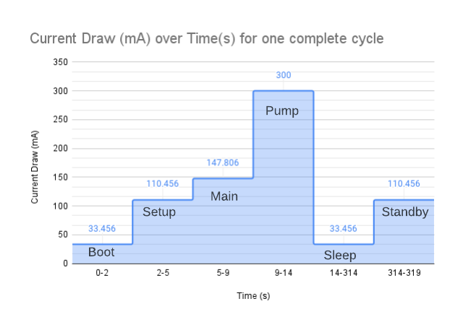
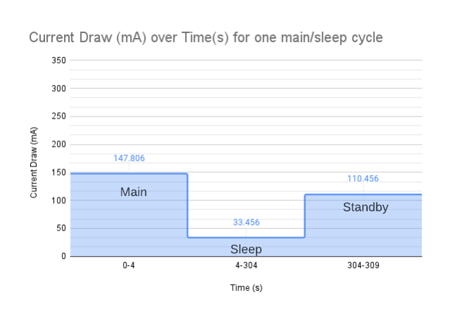
The total power consumption for one actual main/sleep cycle (Excluding the boot, setup and pump cycles) can be calculated as:
The total power consumption for one full cycle can be calculated as:
33.456mA∗2s+110.456mA∗3s+147.806mA∗4s+300mA∗5s+33.456mA∗300s+110.456mA∗5s
=
13078.584mAs≈3.6mAh
147.806mA∗4s+33.456mA∗300s+110.456mA∗5s
=
11180.304mAs≈3.1mAh

Slide 11
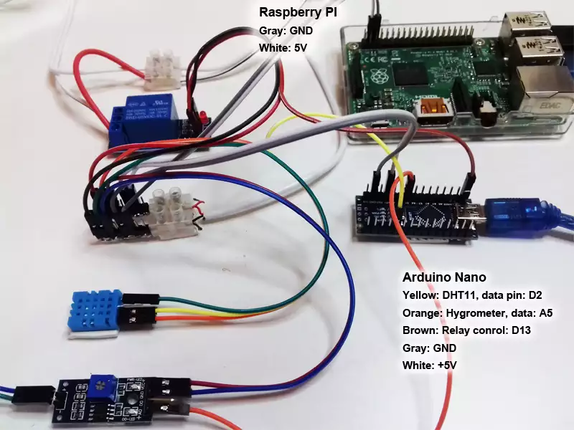
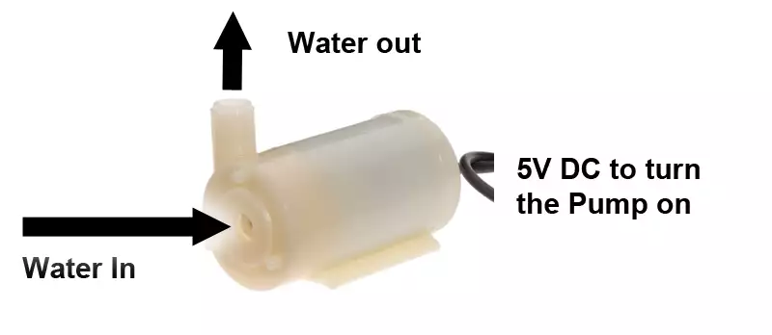
The colorful wires connects the sensors (DHT11, Hygrometer) and the relay to the Arduino pins (Figure 4). The Raspberry Pi, Arduinio and sensors are powered from the same outside power outlet. The DHT11 sends the current humidity and temperature data in digital form to Arduino pin D2. The soil hygrometer sends analog data (to pin A5) which can be converted with an integrated analog to digital converter in the Arduino. The relay can be controlled by setting the digital pin (D13) to output. The relay is essential to turn on or off the submersible pump.

Slide 12
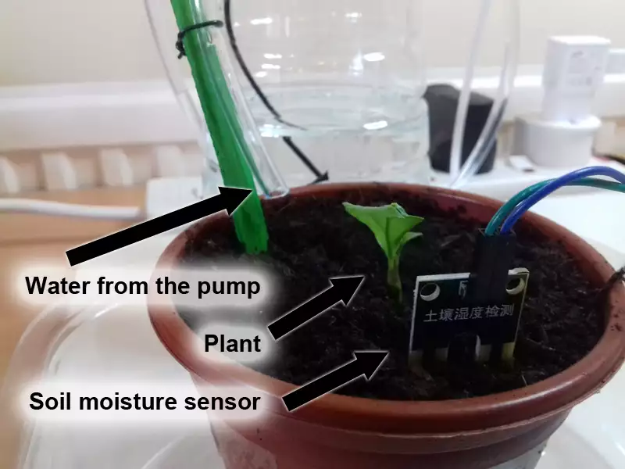
Supplying water and measuring soil moisture
Watering systems can simultaneously water plants and measure soil moisture (Fig.1). This system can precisely calculate the water required in real time. Water is essential for life. It can dissolve minerals from soil so every plant can absorb essential nutrients for their growth. Water required depends on how deep the roots of the plant go. More watery soil can be reached by deeper roots, so even if the top of the soil is dry, deep down it can be wet for the roots.

Slide 13
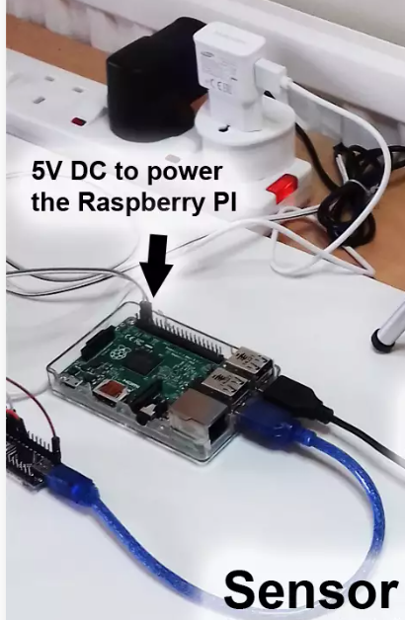
Collecting data on the PC
Raspberry Pi is basicly a small PC that collects data from your plants. If you would like you can control your watering system through any other PC. It is not necessary to use a Raspberry Pi. In this construction a Raspberry Pi 3 is used to save more power and space. It is not necessary to buy a PC just for plant watering.
Data from Arduino and USB camera are cought by the Raspberry Pi (Fig.2). The Raspberry Pi has an internet connection (Wifi or LAN) so it can reach you 24/7 in case of any critical situation requiring human intervention. Through software it can store sensor data in SQL databases and contact you in e-mail or SMS. You could reach your SQL database from anywhere in the world. You can also watch the camera feed of the plant(s) from any remote destination.

Slide 14
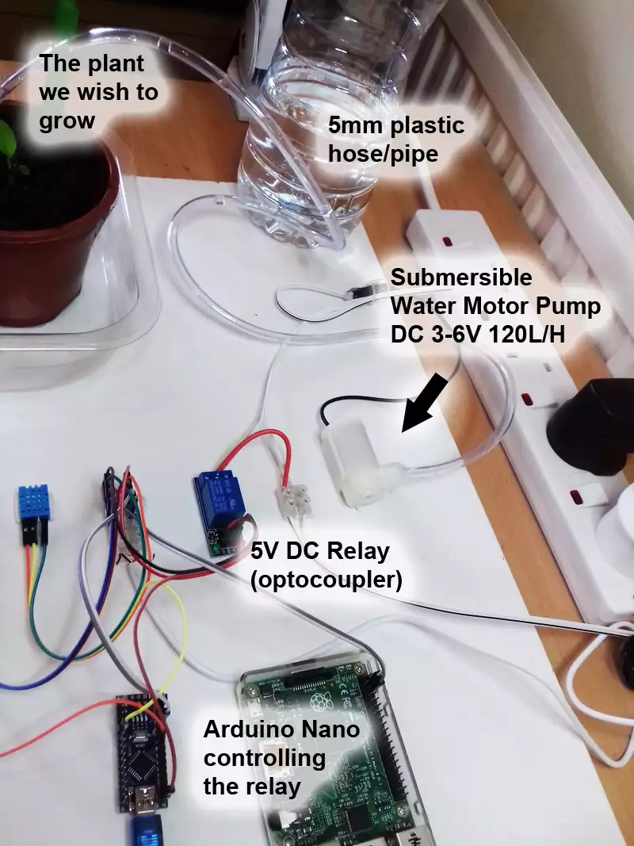
The watering subsystem
This plant watering system has many subsystems, but the most important subsystem is directly responsible for watering soil. The pump controller subsystem has the biggest role (Fig.3 ). A submersible water pump is powered from a DC converter, which is plugged into the power outlet. In this example the pump will be placed in a bottle full of water.
A relay controls the pump. The relay can turn On/Off the pump by controlling the flow the electricity. The relay is controlled by an Ardunio and the Arduino is controlled by the Raspberry Pi with the Devicehandler Communication protocol, which is a set of commands and parameters through the USB port of the Raspberry Pi.
Example code: https://ozeki.hu/p_1557-device-handlers.html

Slide 15
jet pumps
Submersible (Figure 4) and jet pumps are the most commonly used pump types. Submersible pumps push fluid to the surface as opposed to jet pumps having to pull fluids. Please check if only pure water is going through your pump. If the noise of the pump is not familiar or the water pressure is too low than air can be in the pipes. Air in the pipes can cause the pump to overheat. It is also good to know the water temperature to keep the motor safe from overheating.

Slide 16
Collecting soil moisture data
Electricity flow can be measured between moisture sensor legs (Figure 5). Electricity easily flows through watery soil while the throughput of dry soil is nearly 0. The value is sent to one of the analog pins you can find on the Arduino.
The Analog Sensor libraries can be uploaded to the Arduino, because they can handle moisture data and forward it to the Raspberry Pi automatically. Please test or check the watering needs of your plant and set the limits in software. This software can be easily installed on any Raspberry Pi and bigger computers like a PC or laptop.

Slide 17
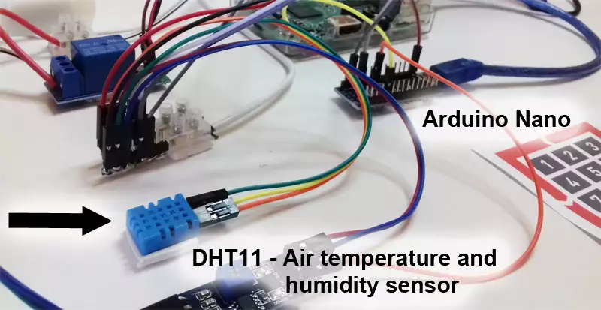
Collecting Air Temperature and Humidity data
DHT sensor is a perfect solution to measure air temperature and humidity which will be sent to the Arduino in digital signals (Figure 6). These signals are automatically transfered every 2 sec in 40 bit packages and Ozeki DHT libraries automatically read them.

Slide 18
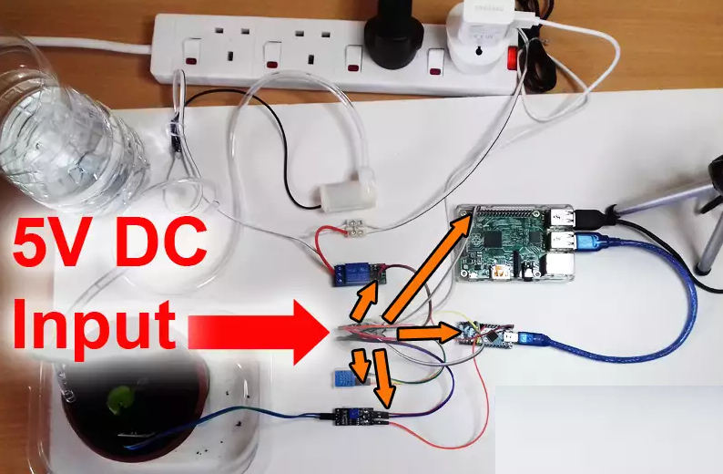
Supplying power to the sensors
All sensors connected to the Arduino are supplied with 5V from the same power outlet (Figure 11). This adapter powers the Arduino and Raspberry Pi as well. The soil moisture sensor needs 5V between the two electrodes you stick in the soil. The DHT sensor needs energy to measure temperatue and humidity. The relay also needs 5V to control the pump.
For example the standard voltage in an USB cable is 5V, which is an industry standard. A different power adapter powers the pump, since it consumes higher power. The original adapter wouldn't be able to handle if we add up the power of the pump. The pump also works with a 5V adapter.
Notes:
https://ozeki.hu/p_2972-plant-watering-system-with-ozeki-10.html

Slide 19
Installation
Computer, LoPy4 & Raspberry Pi 4 Setup
This project was built using Ubuntu 20.04LTS, and the tutorial will show the steps for this OS.
Part 1 - LoPy4 Firmware Upgrade and IDE Setup
:::info This part describes the setup of the microcontroller and the development environment. This will allow you to start programming the controller and upload your project to the device. :::
1. Download the dialog and python-serial package by running these commands in the terminal:
sudo apt install dialog sudo apt install python-serial
The dialog package allows for shell scripts to display helpful dialog boxes to the user, and the python-serial package provides encapsulated access to the serial ports for Python. Both packages are needed to use the pycom firmware upgrade utility.
2. Download the PyCom Firmware Tool and install it:
sudo apt install ./pycom-fwtool-1.16.5-bionic-amd64.deb
3. Connect your LoPy 4 to the expansion board, lining up the pins to match the board - with the led and reset button towards the micro usb port. A clear click should be heard.
4. Connect your LoPy 4 device and expansion board to the computer using an USB 2 port with data transfer and the micro usb cable. Do not use an USB hub. The device should be visible in the list provided by the command: lsusb
5. The device should be located as a serial port device under /dev/ttyACM0. By default, this newly connected device belongs to the dialout group, and your used needs to be added to it:
sudo usermod -a -G dialout [YourUserName]
You need to relog for the changes to apply. To ensure read and write access to the device, it is also sometimes necessary to add read/write access to the serial port device for all users:
sudo chmod a+rw /dev/ttyACM0 Always run this command after reconnecting the device.

Slide 20
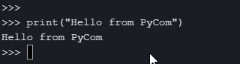
Installation
6. Follow the Updating Device Firmware guide and make sure to:
Select the latest LTS release of Pybytes
Uncheck "Force update Pybytes", "Enable Pybytes/SmartConfig support" since we will not use it
Select File System: FatFS
Check "Erase during update", RESET: "CONFIG partition" and "NVS partition". This is important to get a clean firmware flash and avoid any booting/connection/writing issues.
7. Make sure to get a successful message, else repeat steps 3-6 until successful.
8. Install Atom and the Pymakr plugin by going to settings > Install > search for Pymakr and click install. Pymakr adds a REPL (Read, Evaluate, Print - Loop) console which connects to the flashed MicroPython firmware on the LoPy4 and allows you to run Python code, and upload your project code to the device.
9. Create a new project folder and open Atom and Pymakr. Reconnect your LoPy4, and it should automatically be recognised by the Pymakr plugin. You should now be able to run Python code in the console and upload project code to the device.

Slide 21
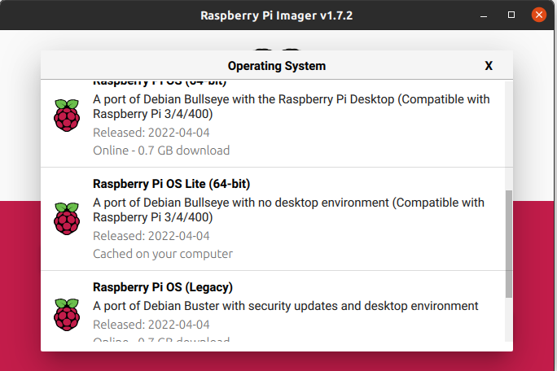
Installation
Part 2 - Raspberry Pi 4 Linux Server Setup
Part 2 Raspberry Pi 4 Linux Server Setup
::::::info This part describes the setup of the backend server which will host the database and web UI. :::
1. Download and install the Raspberry Pi Imager:
sudo apt install ./imager_1.7.2_amd64.deb
2. Connect your Micro-SD card using the Micro-SD reader and run the Raspberry Pi Imager from the applications menu. Select Raspberry Pi OS Lite (64-bit) which is essentially a headless Debian build.

Slide 22
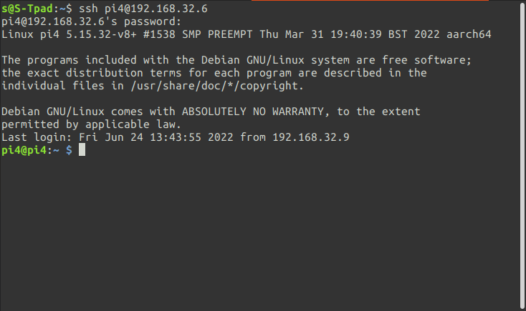
3. Go into advanced options:
Check "Enable SSH" and "Use password authentication"
Configure a username and a password
Check "Configure wireless LAN" and enter your WiFi information.
This will allow the device to automatically connect to your local wireless LAN, and allow you to instantly access the device using SSH.
4. Select the Micro-SD card and press WRITE.
5. When the installation is finished, eject the Micro-SD reader, plug the Micro-SD card into the Raspberry Pi 4, and deploy the device. It should now be up and running and ready to be accessed by SSH.
6. Open up a web browser and access your router settings. Navigate to your connected devices and find your Raspberry Pi 4, and give it a static local IP address. This will make it easier to access the device and ensure reliable connectivity.
7. Open a terminal and use the command:
ssh USERNAME_FROM_STEP_3@RPI4_LOCAL_IP_ADRESS
for example
ssh raspberrypi4@192.168.1.3
8. Enter the password from step 3 and you should be allowed into the system:
9. Update the system: sudo apt update && sudo apt upgrade -y
Install the text editor Vim to be able to edit text files in the later steps. For a cheat sheet on how to use this text editor see this cheat-sheet.
sudo apt install vim

Slide 23
Computer, LoPy4 & Raspberry Pi 4 Setup
This project was built using Ubuntu 20.04LTS, and the tutorial will show the steps for this OS.
Part 1 - LoPy4 Firmware Upgrade and IDE Setup
:::info This part describes the setup of the microcontroller and the development environment. This will allow you to start programming the controller and upload your project to the device. :::
1. Download the dialog and python-serial package by running these commands in the terminal:
sudo apt install dialog sudo apt install python-serial
The dialog package allows for shell scripts to display helpful dialog boxes to the user, and the python-serial package provides encapsulated access to the serial ports for Python. Both packages are needed to use the pycom firmware upgrade utility.
2. Download the PyCom Firmware Tool and install it:
sudo apt install ./pycom-fwtool-1.16.5-bionic-amd64.deb
3. Connect your LoPy 4 to the expansion board, lining up the pins to match the board - with the led and reset button towards the micro usb port. A clear click should be heard.
4. Connect your LoPy 4 device and expansion board to the computer using an USB 2 port with data transfer and the micro usb cable. Do not use an USB hub. The device should be visible in the list provided by the command: lsusb
5. The device should be located as a serial port device under /dev/ttyACM0. By default, this newly connected device belongs to the dialout group, and your used needs to be added to it:
sudo usermod -a -G dialout [YourUserName]
You need to relog for the changes to apply. To ensure read and write access to the device, it is also sometimes necessary to add read/write access to the serial port device for all users:
sudo chmod a+rw /dev/ttyACM0 Always run this command after reconnecting the device.

Slide 24
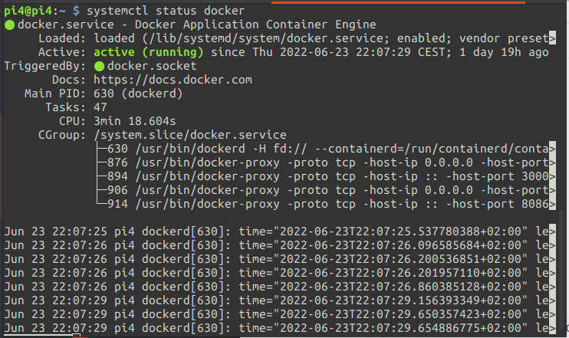
Installation
Part 3 - Docker setup
:::info This part describes the setup of Docker, which will be used to run the TIG-Stack: the Telegraf Server Agent used to collect data, InfluxDB which is the database storing the data, and Grafana which is the analytics service with a web UI for monitoring the database. :::
1. Install the Docker Engine, CLI, Container daemon and Docker Compose using the Docker Convenience Script which is the easiest way for Raspbian OS:
curl -fsSL https://get.docker.com -o get-docker.sh
then
sudo sh get-docker.sh
If successful, the docker service should be up and running. Check with:
systemctl status docker
Now you should be ready to build, configure and deploy the system.

Slide 25
Platform
Choice of database
Adafruit IO for its service as an MQTT broker. This is a cloud provider that will allow the system to expand by opening up the possibility of additional subscribers/publishers to the system. For example you can set up another microcontroller with sensors at another location and publish its data to Adafruit, and have this data accessible on the TIG-stack back end. You can also for example allow your friends to subscribe to your data feed, so they also can set up a monitoring solution and monitor the same data.
InfluxDB as the database manager, since it is made specifically for time series data. Since it's a relation-ish system with the query language InfluxQL (SQL Dialect) it's easy to get started with if you have some knowledge of relational databases. Using Telegraf, which plays well with both InfluxDB and Grafana, as an agent for collecting the data over MQTT makes the data collection very easy.
Grafana is very easy to configure, and InfluxDB can easily be added as a data source. Collects data from the database using InfluxQL/Flux queries which you can write yourself or build from a gui tool. Easy to build and customize dashboards according to your needs, and very easy to set up webhooks for alerting.
Using these services together with Docker-compose really makes deploying and configuring this TIG-stack very easy. I also wanted to explore docker, use my linux background with self hosting and make the system scalable.

Slide 26
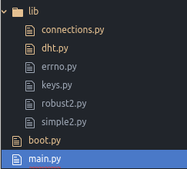
Lopy4
The files located in the lib directory are libraries(drivers) for different aspects of the project.
Connections.py is my own library which handles WLAN and MQTT connections.
errno.py is constants for different error codes related to MQTT connections.
keys.py is where WLAN and MQTT credentials are stored. (Not a secure solution for a production system, but fine for an isolated device inside a home network with no sensitive data)
dht.py is a driver for the DHT-11 sensor, which provides functionality for processing and interpreting the digital signals from the sensor.
simple2.py and robust2.py are MQTT drivers, where simple2 provides a barebones MQTT client, and robust2 provides extra functionality such as reconnection handling.
boot.py gets executed when the device is booted, and simply calls the wlan_connect function using the credentials stored in keys.
The operation is also timed for metrics.

Slide 27
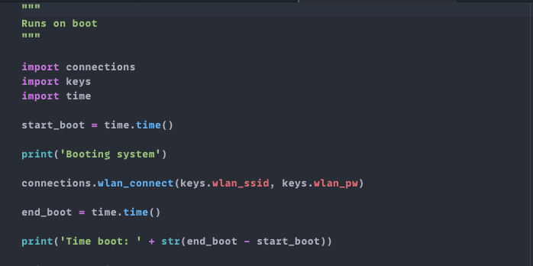
The operation is also timed for metrics.
main.py is the main program for the device, which contains the setup and main cycle.
The setup part can be seen below. Necessary imports are made, including the pycom module for accessing device features such as the embedded LED for status indications, the time module for halting execution, the Pin module for defining pin functionality, ADC for analog-digital conversion from the analog sensors, and machine.sleep for access to a light sleep mode which disables the WLAN connection and other parts. json is imported in order to format the data to be transmitted as JSON.

Slide 28
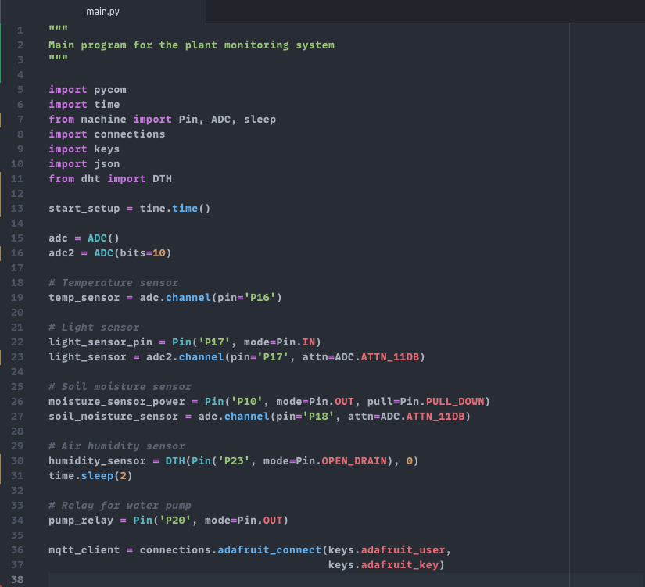
The setup cycle is then timed, two adc-channels are set up to process analog signals, and the connections for all the sensors, the separate power supply to the moisture sensor and the pump relay are defined. Finally an MQTT connection is established to the Adafruit MQTT broker.

Slide 29
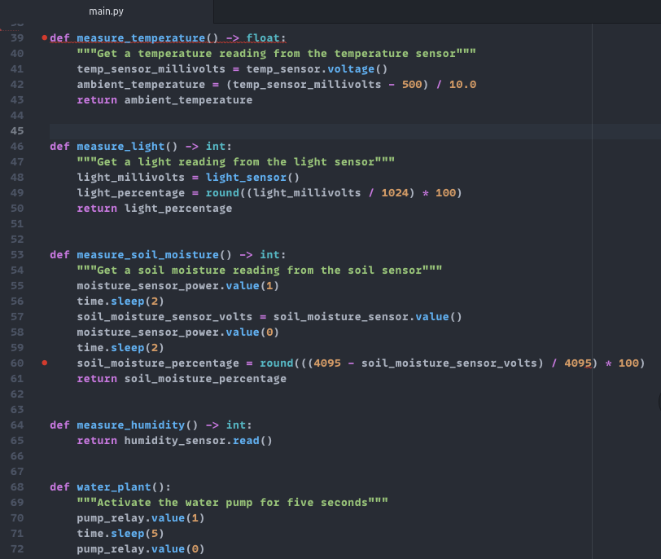
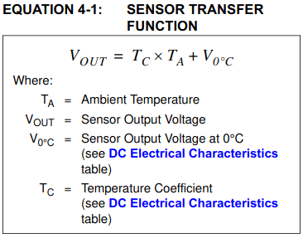
This is followed by function definitions for the sensor measurements and the activation of the water pump.
The temperature and light sensors are analog, which means that a voltage reading is taken. Depending on the resolution of the ADC channel, you will get a certain binary value. In measure_light() For example, the resolution is 10 bits - which means a reading from 0 - 1024 is possible. On this voltage, you then need to apply an equation to extract the metric of interest. These equations are (hopefully) available in the datasheet for the sensor. This is the equation for the MCP9700 temperature sensor extracted from the datasheet:

Slide 30
For the light sensor, a calculation is made to extract the light percentage value. The value from this sensor is not a linear value, and not tied to an SI unit - so you can only extract a relative value from it - that's why a percentage can be appropriate. There is no equation yielding a result of a certain unit like above.
The same principle is applied in the measure_soil_moisture() function since that sensor is also analog. This sensor however also takes damage from a constant voltage supply, which means you need to power it only when measuring in order to preserve its lifetime. The sensor is powered, then execution halted in order to make sure it's sufficiently powered, a reading is taken and then it is unpowered.
The humidity sensor is digital, and the read() method from its driver can be employed directly to extract a useful value.
The water_plant() function simply issues a high control signal, which closes the relay and activates the pump circuit, waits five seconds and then issues a low control signal which opens the circuit. The result is pumping water into the plant for 5 seconds.
Then follows the definition for two reconnection functions. connect_wlan_adafruit() lights the device LED yellow in order to notify that there has been a WLAN connection issue, and makes a new fresh wlan connection, followed by a new adafruit connection.
reconnect_adafruit() lights the device LED green in order to notify that there has been an MQTT connection issue, and then tries to reconnect and reestablish the connection.

Slide 31
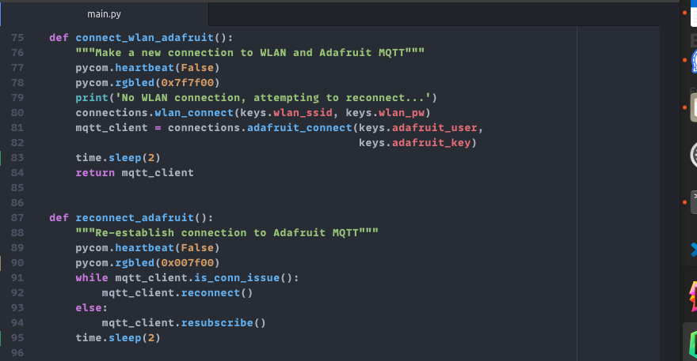
Then follows the definition of the main function, which constitutes the main loop cycle.

Slide 32
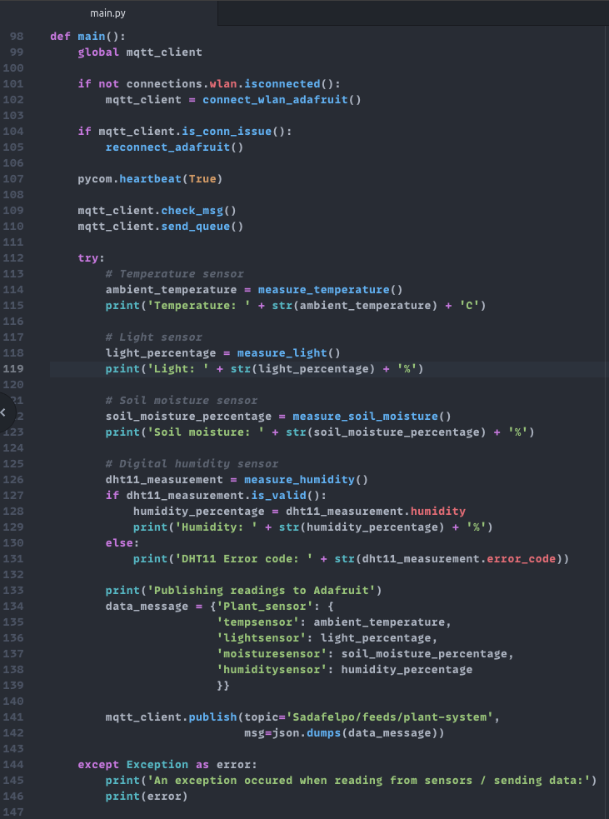
First, the connections are tested - and re established if there are any issues. The LED blue heartbeat is activated to indicate that the main cycle is running. The MQTT message queue is checked and sent, then readings are collected from all sensors, sensor data is formatted as a JSON object and published to Adafruit. Since the DHT11 digital sensor is highly based on signal timing, the reading can sometimes be corrupted with data loss or checksum errors. If this occurs, the error code is printed and the exception is handled.

Slide 33
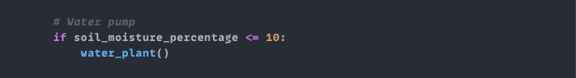
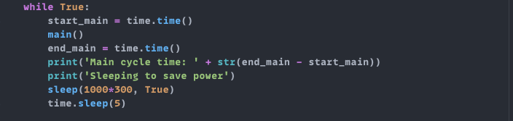
Finally the plant is watered if the soil is very dry.
This is the loop which drives the system. The sleep cycle can easily be adjusted by increasing/decreasing the time in the sleep() function. The True argument re-enables the WiFi module after sleeping, and a small execution halt of 5 seconds ensures the connection is properly established before commencing the next cycle.

Slide 34
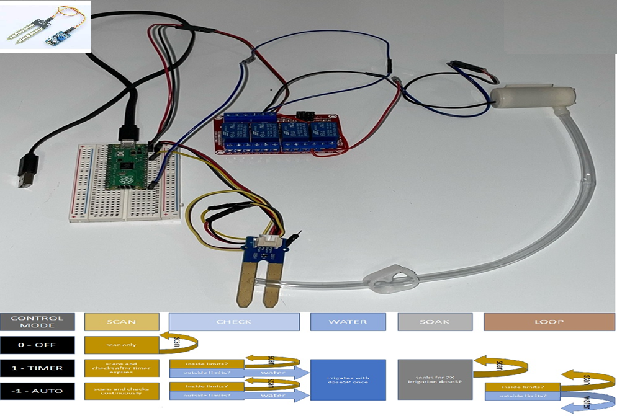
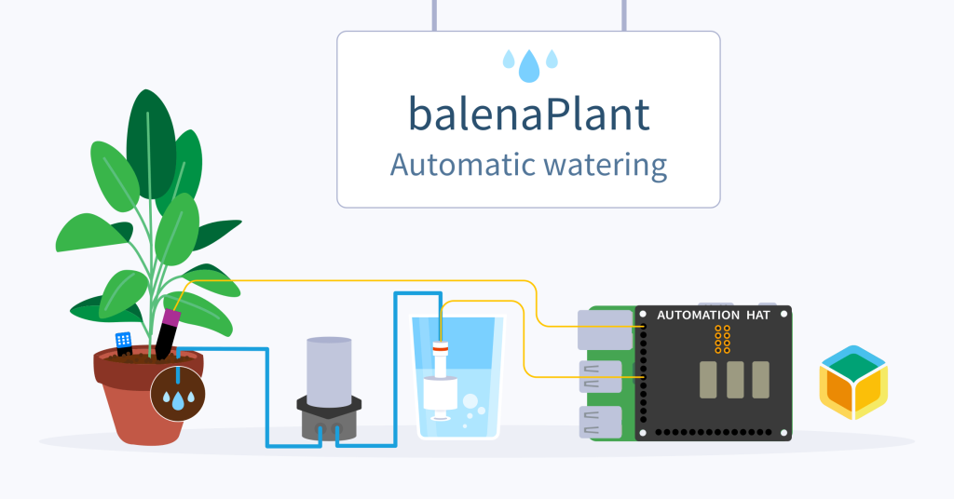
Notes:
https://blog.balena.io/keep-your-plant-friends-happy-and-healthy-with-automated-watering-balenaplant/

Slide 35
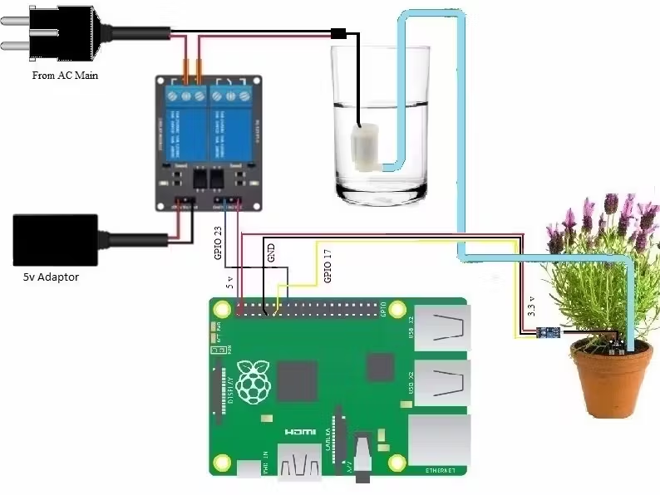
Smart Home Gardening System Using Raspberry Pi
#!/usr/bin/env python
# encoding: utf-8
import os
import smtplib
from email import encoders
from email.mime.base import MIMEBase
from email.mime.multipart import MIMEMultipart
import RPi.GPIO as GPIO
from time import sleep
COMMASPACE = ', '
def SendEMail():
sender = ‘amelcharolinesgn@gmail.com'
gmail_password = ‘1239620955777'
recipients = ['mtech.kiran@gmail.com']
# Create the enclosing (outer) message
outer = MIMEMultipart()
outer['Subject'] = 'Soil is about to dry and water will be poured'
outer['To'] = COMMASPACE.join(recipients)
outer['From'] = sender
outer.preamble = 'You will not see this in a MIME-aware mail reader.\n'
composed = outer.as_string()
# Send the email
try:
with smtplib.SMTP('smtp.gmail.com', 587) as s:
s.ehlo()
s.starttls()
s.ehlo()
s.login(sender, gmail_password)
s.sendmail(sender, recipients, composed)
s.close()
print("Email sent!")
except:
print("Unable to send the email. Error: ", sys.exc_info()[0])
raise
GPIO.setmode(GPIO.BCM)
GPIO.setup(17, GPIO.IN)
GPIO.setup(23, GPIO.OUT)
GPIO.output(23, GPIO.HIGH)
while (True):
if GPIO.input(17):
print("Need to Water The Garden and Water Pump will be Switched On")
SendEMail()
GPIO.output(23, GPIO.LOW)
while (True):
if not GPIO.input(17):
GPIO.output(23, GPIO.HIGH)
break
else:
print("Soil has enough Moisture")
Notes:
https://www.hackster.io/mtechkiran/smart-home-gardening-system-using-raspberry-pi-1570a7
https://www.instructables.com/PlantyPi-a-Raspberry-Pi-Pico-Plant-Watering-Device/

Slide 36
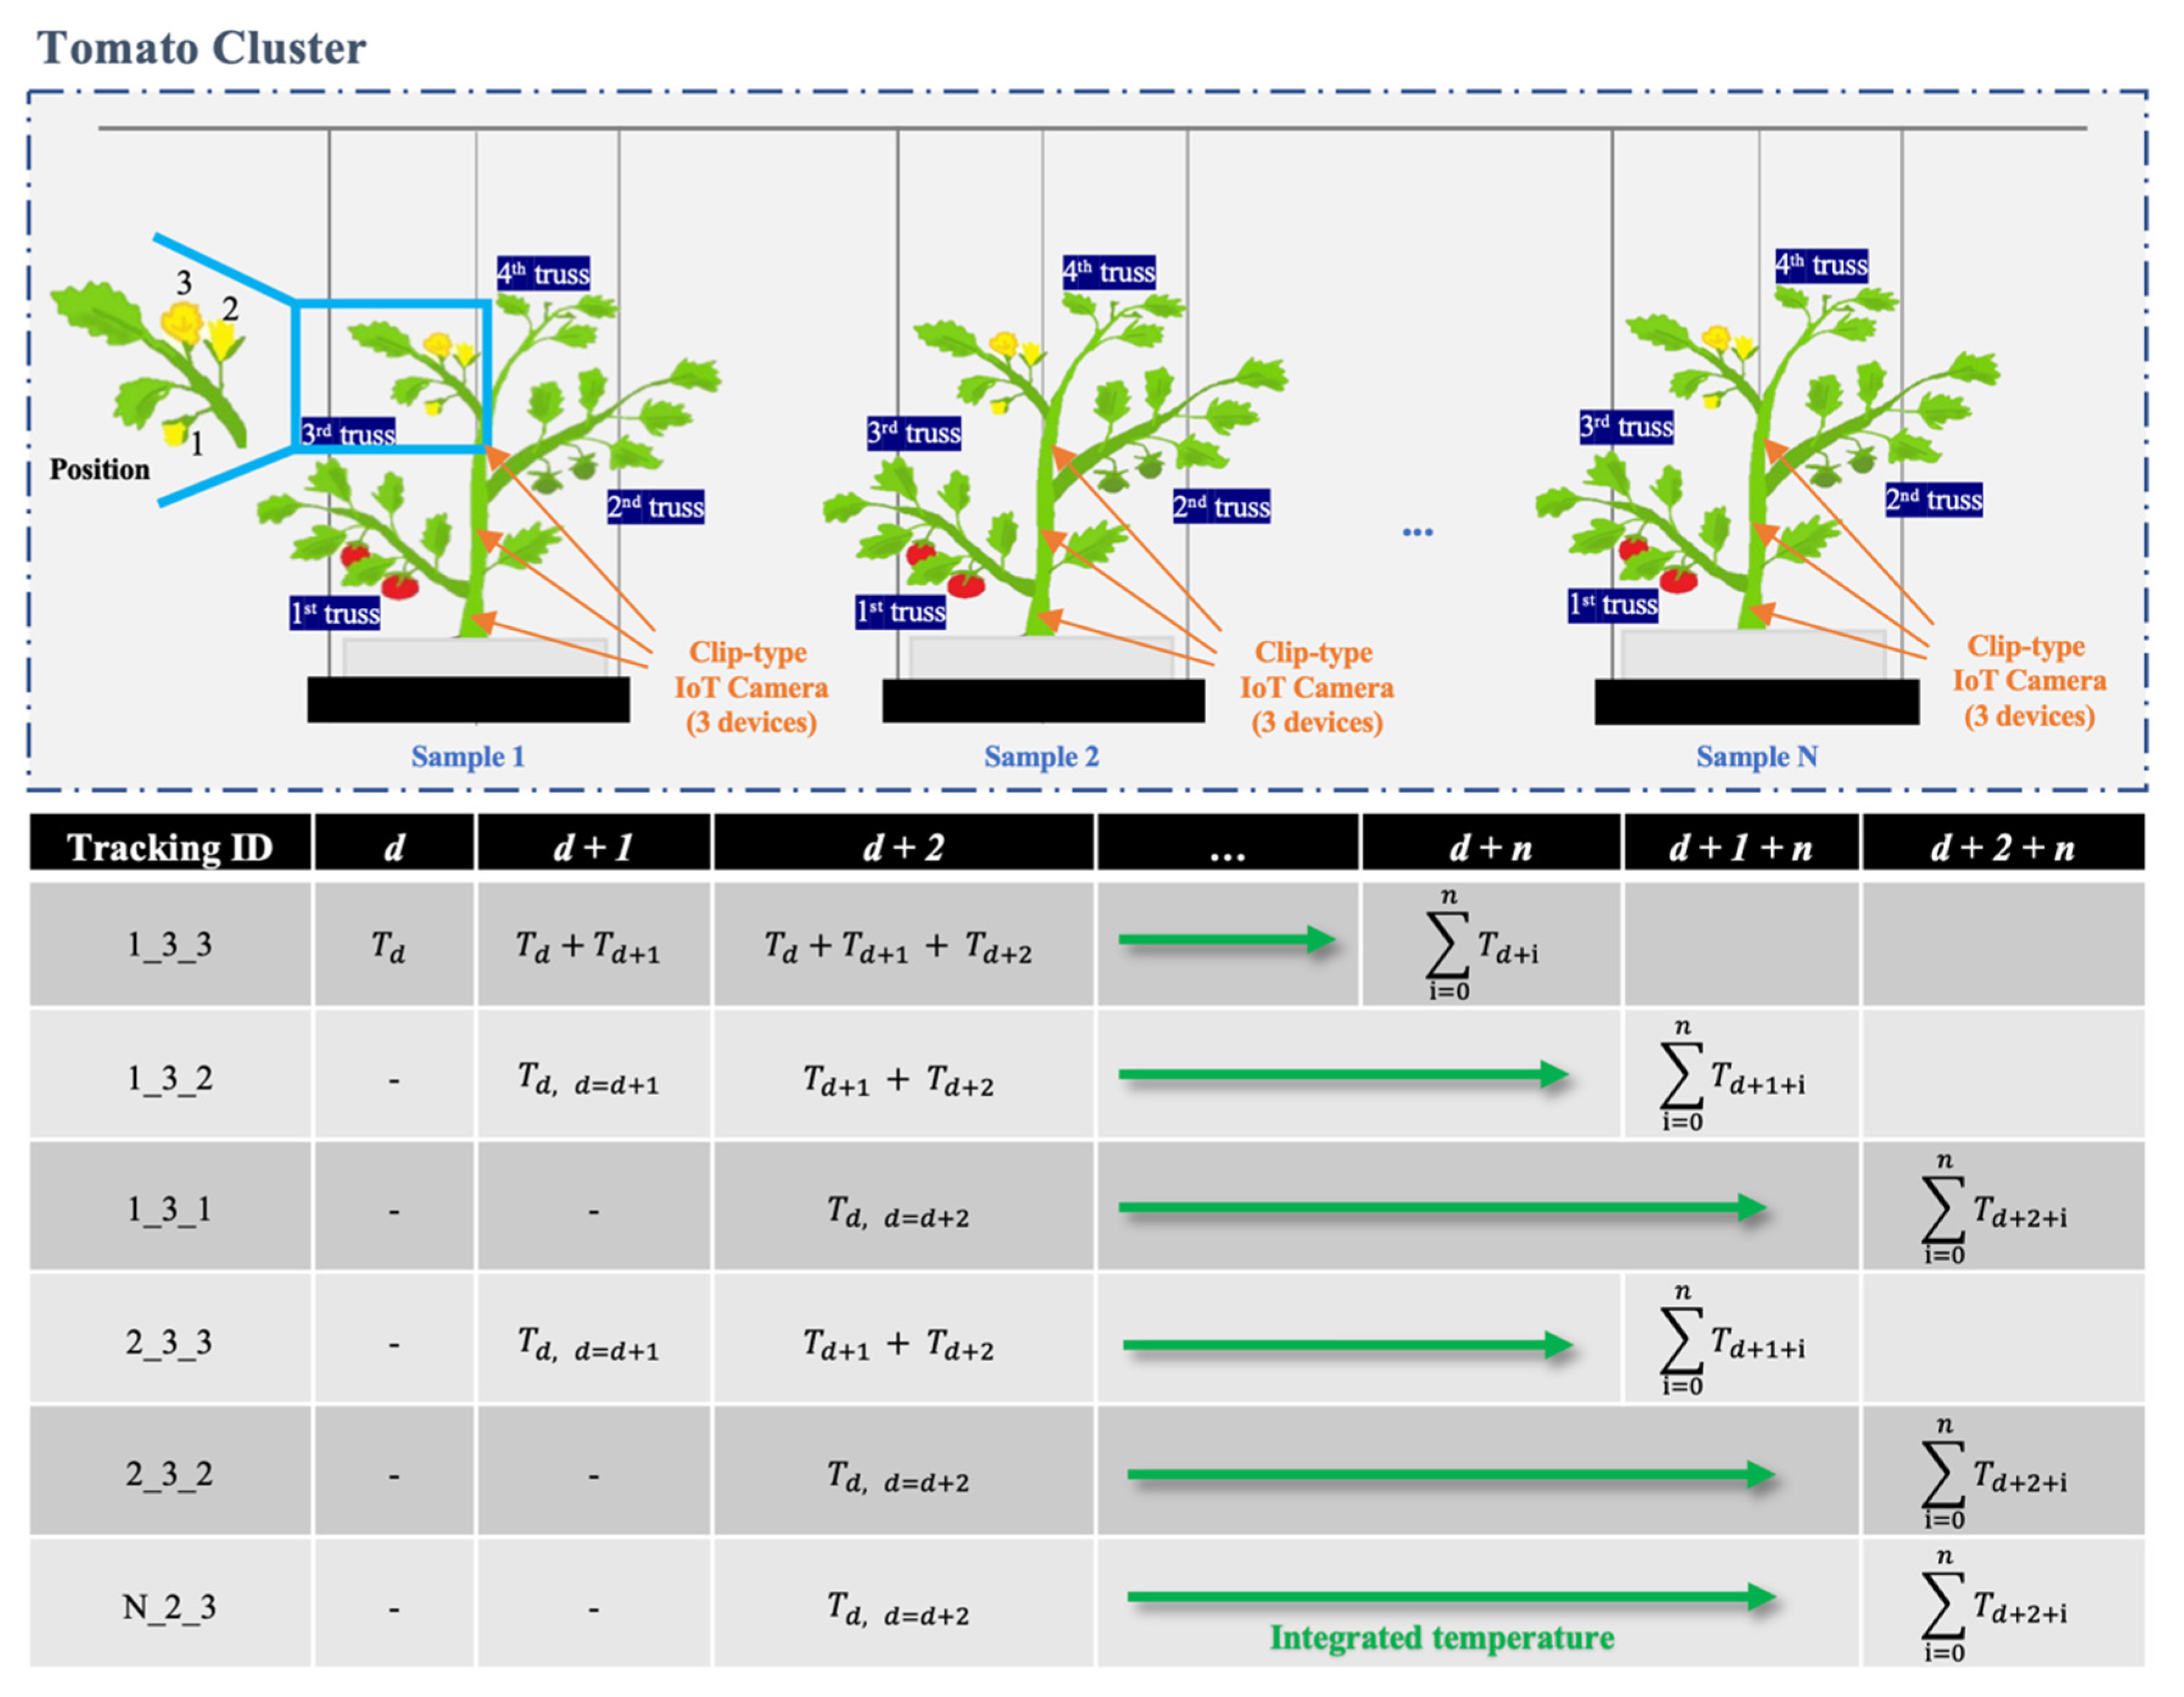
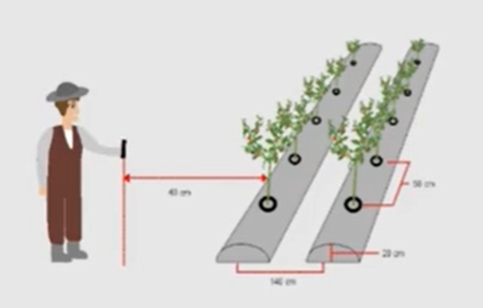
An Automated, Clip-Type, Small Internet of Things Camera-Based Tomato ...
Notes:
GitHub - kushan-chandima/YOLOV8-chili-disease-control: A smart chili plant disease detection and targeted pesticide spraying system using YOLO object detection and a mini sprayer mechanism to reduce chemical usage and improve crop health.
Automatic Counting of Chili Ripeness on Computer Vision
https://github.com/kushan-chandima/YOLOV8-chili-disease-control
An Automated, Clip-Type, Small Internet of Things Camera-Based Tomato ...

Slide 37
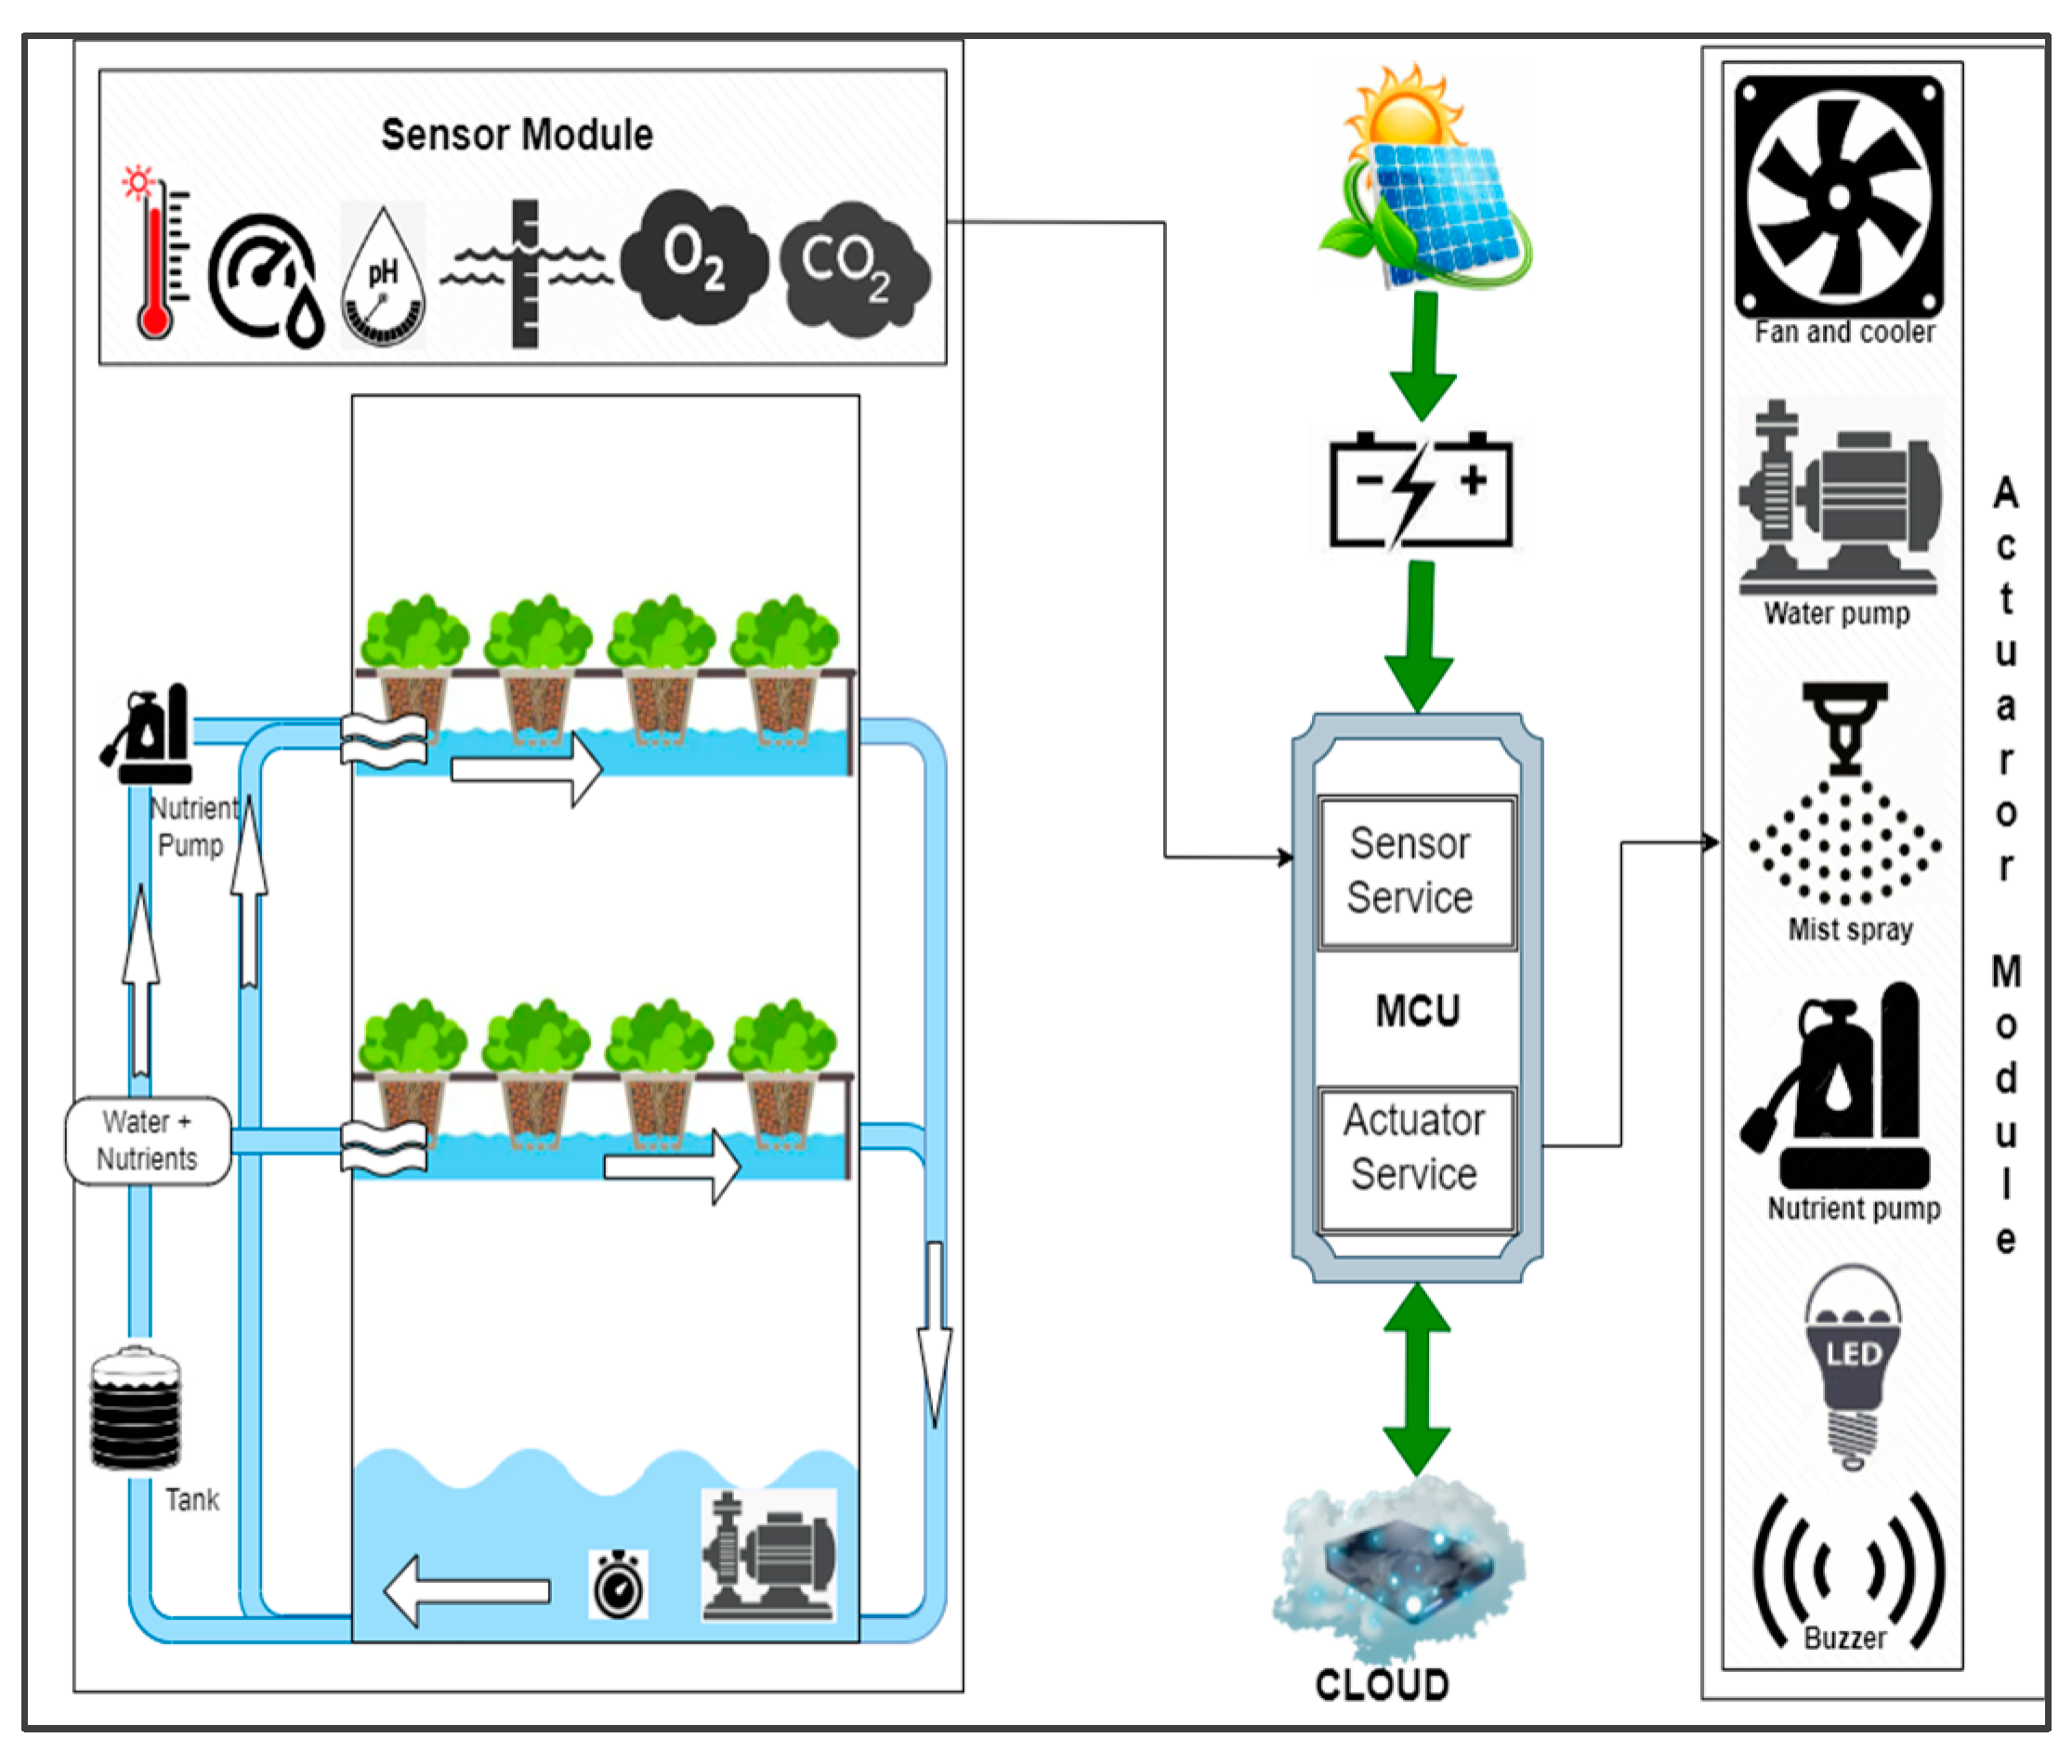
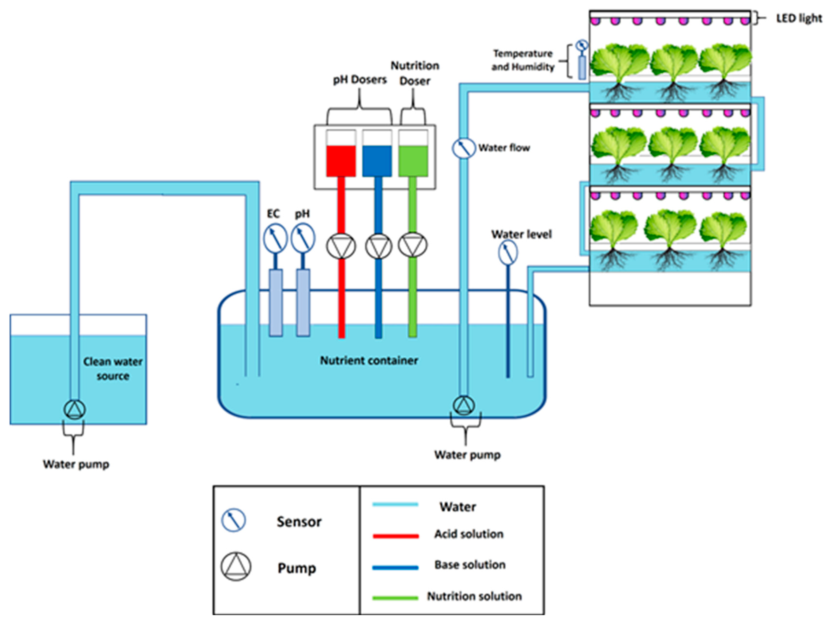

Slide 38
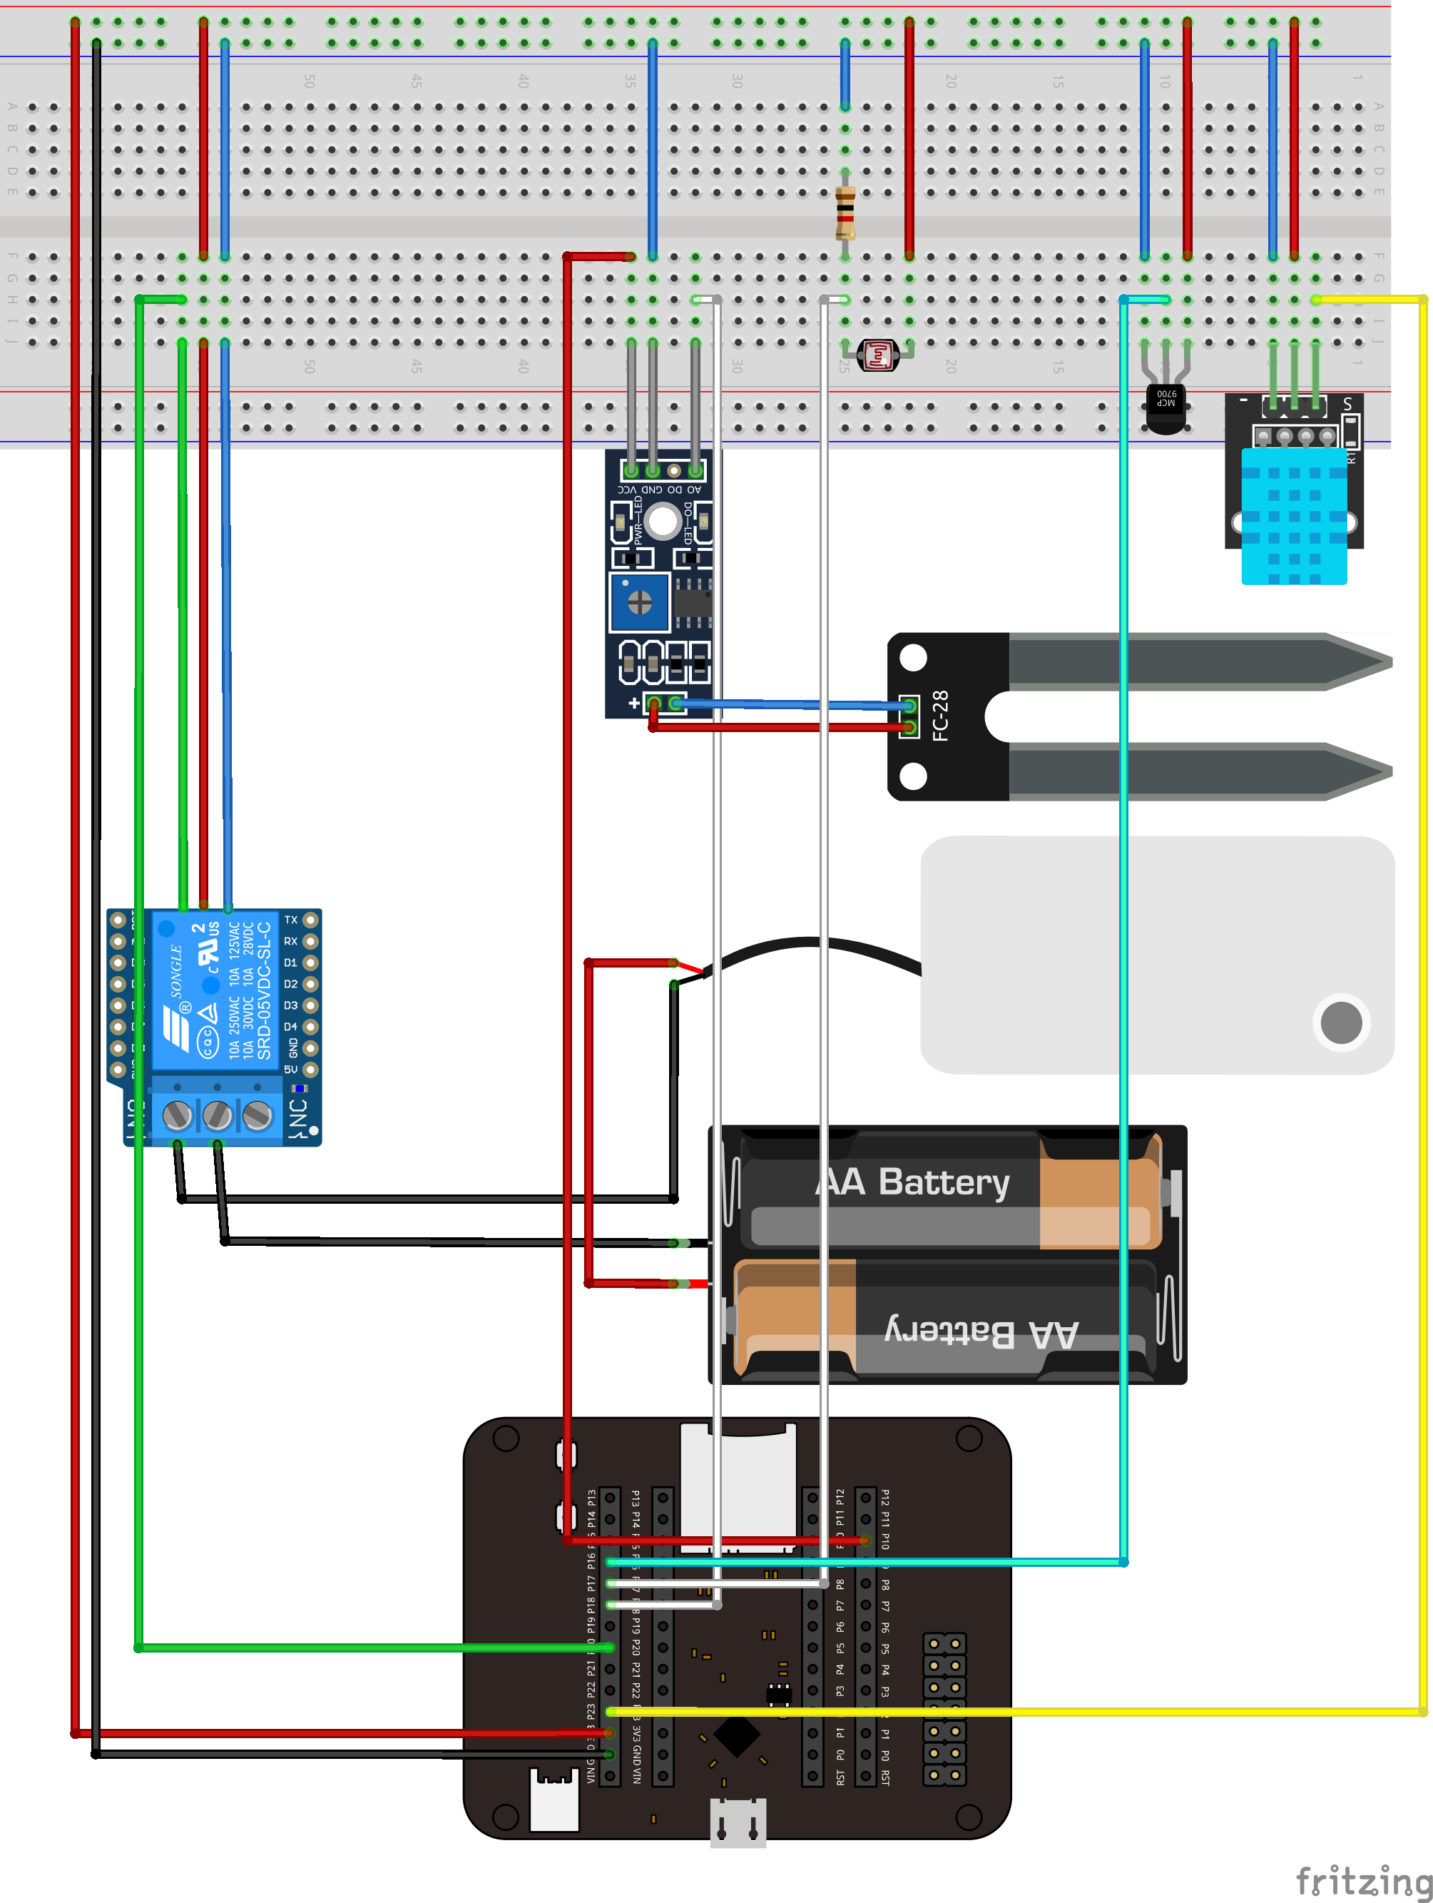
Deep Learning techniques for plant growth classification
Build an Automated Plant Monitoring System
https://github.com/SamuelThand/Automated-Plant-Monitoring-System
https://github.com/KiselevaElizavetaA/plant_growth_stage
Deep Learning-Based Direct Leaf Area Estimation using Two RGBD Datasets for Model Development.
https://arxiv.org/html/2503.10129v1
Notes:
https://github.com/CodeByPinar/Plant-Health-Monitoring

